Slide 1


PHARMACY MANAGEMENT SYSTEM
K.RAMAKRISHNAN COLLEGE OF TECHNOLOGY
JANANI S (2403811720522022)
JESINTHA A (2403811720522024)
LATHIKA C (2403811720522027)
MADHUBALA S (2403811720522029)
GUIDED BY
A.MALARMANNAN M.E

Slide 2
Problem Statement
Pharmacies manage large volumes of data on medicines, suppliers, prescriptions, and sales that require high accuracy.
Manual record-keeping leads to stock mismatches and duplicate entries.
Tracking medicine availability and expiry dates becomes difficult.
Manual processes cause billing errors and poor supplier management.
Inconsistent data can lead to financial loss and incorrect medicine distribution.
A structured, normalized database system is therefore required.
Such a system reduces redundancy, maintains consistency, and supports accurate decision-making.

Slide 3
Objectives of the Project
To design and implement a structured, normalized database for a Pharmacy Management System.
To efficiently manage medicine inventory, supplier details, prescriptions, and sales data.
To eliminate data redundancy and ensure consistency and integrity using primary and foreign keys.
To enable accurate stock tracking, expiry monitoring, and efficient billing.
To organize data into well-related tables for better management.
To improve operational efficiency, reduce manual errors, and allow faster information retrieval.

Slide 4
System Requirements
The system requires both hardware and software components for efficient operation.
A computer with adequate processing power, memory, and storage is needed to handle database tasks.
Software requirements include an operating system, a DBMS (e.g., MySQL or Oracle), and a user interface.
The system supports data entry, storage, retrieval, and report generation with reliability and security.
Basic input and output devices such as a keyboard, mouse, and printer are required for billing and documentation.

Slide 5
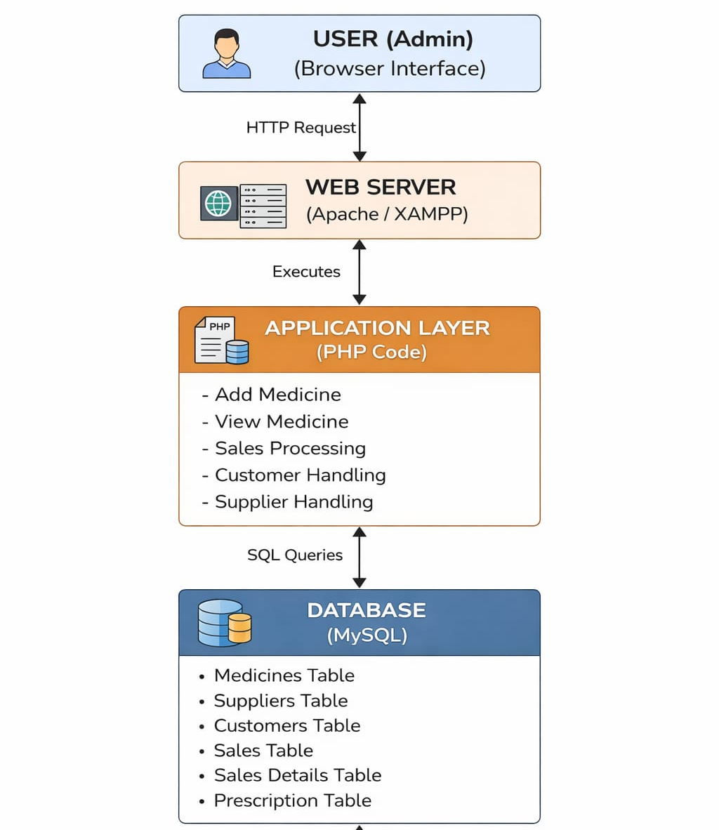
System Architecture

Slide 6
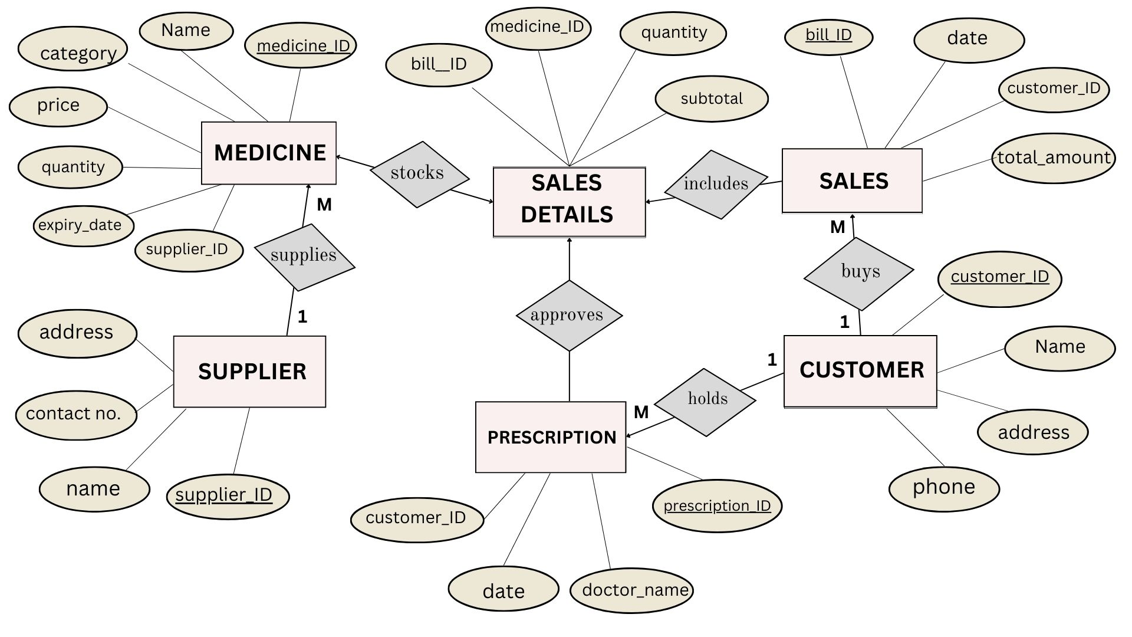
ER Diagram

Slide 7
Relational Schema
The relational schema defines the database structure using tables, attributes, primary keys, and relationships.
Major components such as medicines, suppliers, prescriptions, and sales are stored in separate tables.
This separation reduces redundancy and maintains data integrity.
Primary keys uniquely identify each record in a table.
Foreign keys link related tables and ensure consistency.
The structured design follows normalization principles for efficient storage and retrieval.
It organizes pharmacy data logically for effective management and reporting.

Slide 8
Normalization
Normalization organizes database data to reduce redundancy and improve integrity.
Data is divided into multiple related tables based on logical relationships.
Each table stores specific information about entities such as medicines, suppliers, prescriptions, and sales.
Primary and foreign keys maintain relationships between tables.
This process eliminates duplicate data and prevents insertion, deletion, and update anomalies.
It ensures data consistency, efficient storage, and reliable information retrieval.

Slide 9
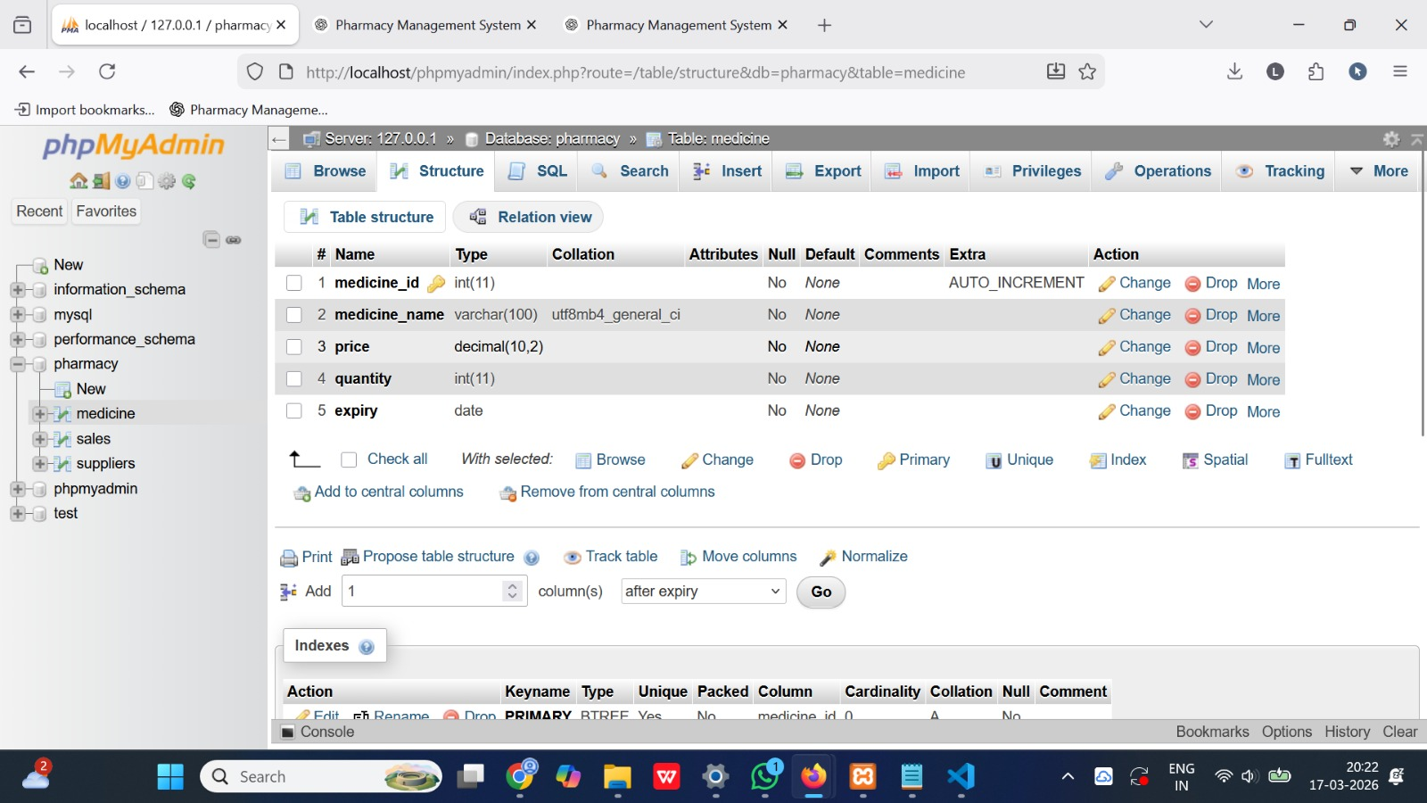
Database and Table Creation
Medicine Table
Supplier Table
Sales details table
Prescription Table
Customer Table

Slide 10
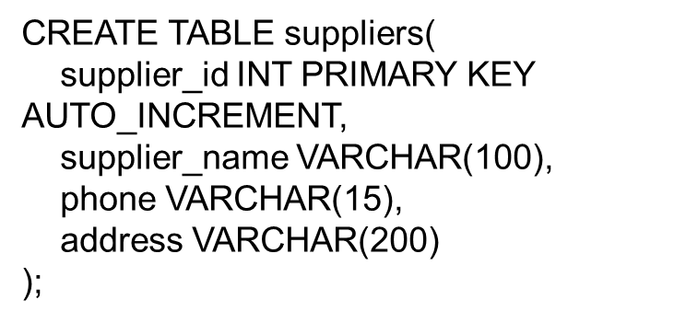
SQL Implementation & Queries
CREATE TABLE medicines(
medicine_id INT PRIMARY KEY AUTO_INCREMENT,
medicine_name VARCHAR(100),
supplier_id INT,
price DECIMAL(10,2),
quantity INT,
expiry_date DATE
);

Slide 11
SQL Implementation & Queries
CREATE TABLE prescriptions(
prescription_id INT PRIMARY KEY AUTO_INCREMENT,
patient_name VARCHAR(100),
doctor_name VARCHAR(100),
date DATE
);
CREATE TABLE sales(
sale_id INT PRIMARY KEY AUTO_INCREMENT,
medicine_id INT,
quantity INT,
total_price DECIMAL(10,2),
sale_date DATE,
);

Slide 12
SQL Implementation & Queries
CREATE TABLE customers( customer_id INT PRIMARY KEY AUTO_INCREMENT, customer_name VARCHAR(100), phone_number VARCHAR(15), email VARCHAR(100), address VARCHAR(255)););

Slide 13
Medicine Management Module
Purpose:
This module manages all information related to medicines available in the pharmacy.
Explanation:
The pharmacy stores different types of medicines with details such as name, price, quantity, and expiry date. This module helps maintain an organized record of all medicines in the database.
Functions:
Add new medicines to the database
Update medicine details
Delete medicine records
Check available stock
Track expiry dates

Slide 14
Supplier Management Module
Purpose:
This module manages the suppliers who provide medicines to the pharmacy.
Explanation:
Pharmacies purchase medicines from different suppliers. The system stores supplier details so that the pharmacy can easily track the source of medicines and maintain supplier records.
Functions:
Add supplier details
Update supplier information
View supplier list
Store contact and address details

Slide 15
Prescription Management Module
Purpose:
This module manages doctor prescriptions given to patients.
Explanation:
Doctors prescribe medicines to patients, and the pharmacy must maintain these records. This module stores prescription details such as patient name, doctor name, and prescribed medicines.
Functions:
Record prescription details
Store patient and doctor information
Verify prescribed medicines

Slide 16
Sales and Billing Module
Purpose:
This module handles the selling of medicines and billing process.
Explanation:
When a customer purchases medicine, the system records the transaction and generates the bill. It also updates the stock quantity in the database.
Functions:
Record medicine sales
Calculate total price
Generate billing information
Update medicine stock after sale

Slide 17
Customer Module
Purpose: This module manages customer information and maintains records of all customers in the system.
Explanation: When a new customer interacts with the system, their details are recorded and stored in the database. The module helps in retrieving, updating, and managing customer data efficiently. It also supports linking customer details with their purchase history for better tracking and service.
Functions:
Add new customer details
Update existing customer information
View customer records
Delete customer data if necessary
Track customer purchase history

Slide 18
Challenges Faced
Designing a proper database structure for medicines, suppliers, prescriptions, and sales.
Maintaining data integrity and avoiding duplicate records.
Applying database normalization to reduce redundancy.
Managing relationships between tables using primary and foreign keys.
Writing accurate SQL queries for data insertion, updating, and retrieval.

Slide 19
Conclusion
The system efficiently manages medicine inventory, suppliers, prescriptions, and sales data in a structured way.
A normalized database reduces redundancy and ensures data consistency.
It improves the accuracy of pharmacy operations.
Enables reliable stock tracking and efficient billing.
Minimizes manual errors and operational difficulties.
Enhances productivity and supports informed decision-making.
Ensures safe and effective management of pharmacy information.

